Slide 1
Dimensional Data Modeling
A Primer
SQL Saturday Madison – April 11,2015

Slide 2
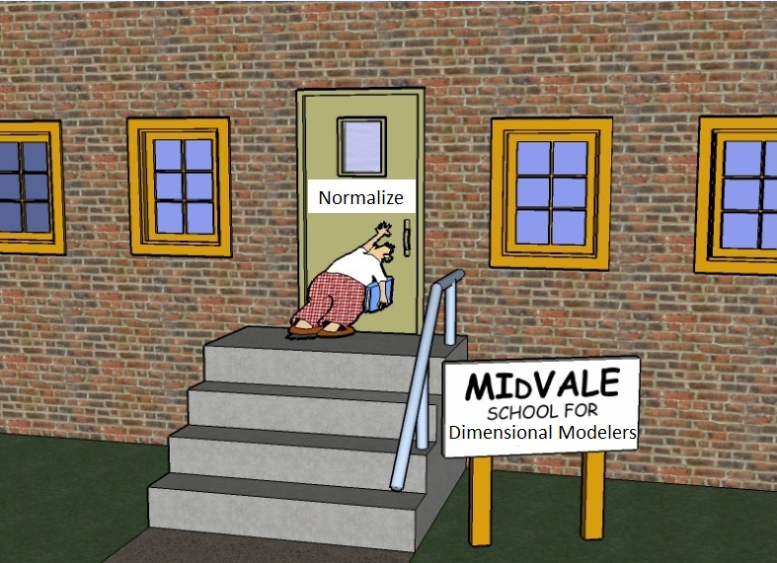



@tbunio
tbunio@protegra.com
agilevoyageur.wordpress.com
www.protegra.com

Slide 3
Who Am I?
Terry Bunio
Data Base Administrator
Oracle
SQL Server 6,6.5,7,2000,2005,2008,2012
Informix
ADABAS
Data Modeler/Architect
Investors Group, LPL Financial, Manitoba Blue Cross, Assante Financial, CI Funds, Mackenzie Financial
Normalized and Dimensional
Agilist
Innovation Gamer, Team Member, SQL Developer, Test writer, Sticky Sticker, Project Manager, PMO on SAP Implementation

Slide 4
Previous SQL Saturday Presentations
SQL Sat Winnipeg 2014
Breaking Data – Stress test using Ostress
SQL Sat Madison/Minneapolis 2014
A data driven ETL test framework
SQL Sat Minneapolis 2013
Agile Data Warehouse
SQL Sat Fargo 2013
SSRS and SharePoint – there and back again

Slide 5


Slide 6


Slide 7


Slide 8


Slide 9
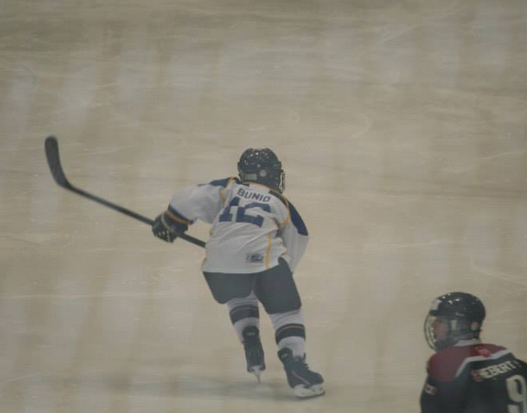

Slide 10
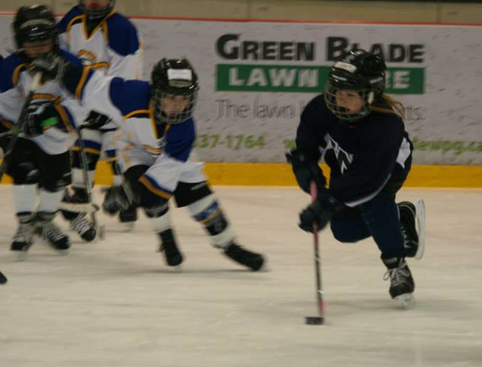

Slide 11
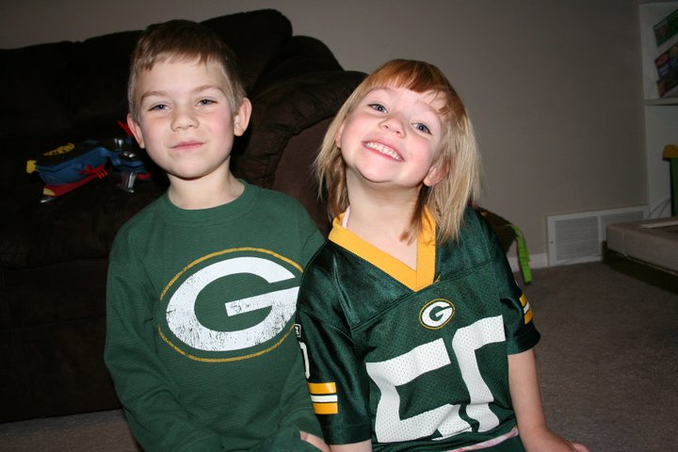

Slide 12


Slide 13
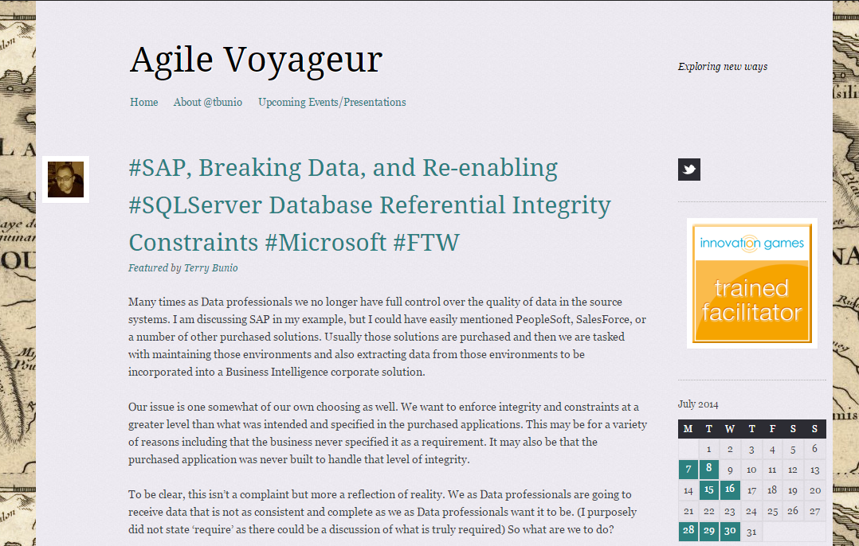
www.agilevoyageur.com

Slide 14
Agenda
Data Modeling
#1 mistake In Data Modeling
Database Design Methods
Dimensional concepts
Facts
Dimensions
Complex Concept Introduction
Why and How?
My Top 10 Dimensional Modeling Recommendations

Slide 15
Definition
“A database model is a specification describing how a database is structured and used” – Wikipedia

Slide 16
Definition
“A data model describes how the data entities are related to each other in the real world” – Terry (5 years ago)
“A data model describes how the data entities are related to each other in the application” – Terry (today)

Slide 17
Data Model Characteristics
Organize/Structure like Data Elements
Define relationships between Data Entities
Highly Cohesive
Loosely Coupled

Slide 18
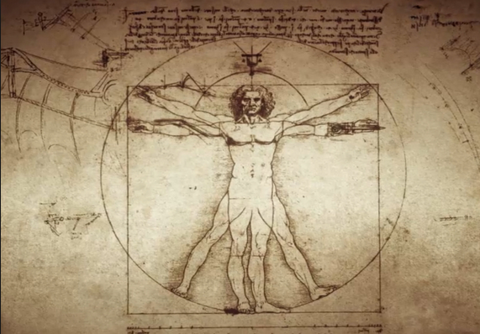
Anthropomorphism

Slide 19
#1 Mistake in Data Modeling
Modeling something to take on human characteristics or characteristics of our world

Slide 20

Amazon

Slide 21
Amazon
Warehouse is organized totally randomly
Although humans think the items should be ordered in some way, it does not help storage or retrieval in any way
In fact in hurts it by creating ‘hot spots’ for in demand items

Slide 22
Data Model Anthropomorphism
We sometimes create objects in our Data Models are they exist in the real world, not in the applications

Slide 23
Data Model Anthropomorphism
This is usually the case for physical objects in the real world
Companies/Organizations
People
Addresses
Phone Numbers
Emails

Slide 24
Data Model Anthropomorphism
Why?
Do we ever need to consolidate all people, addresses, or emails?
Rarely
We usually report based on other filter criteria
So why do we try to place like real world items on one table when applications treat them differently?

Slide 25
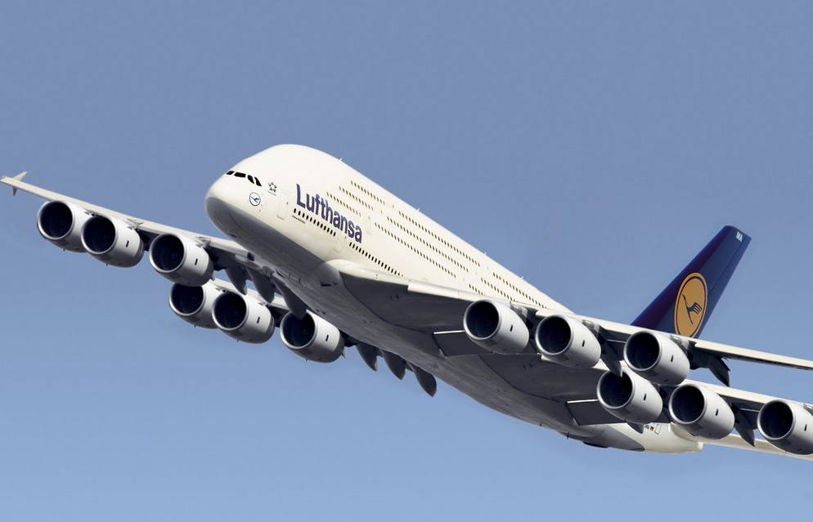
Over Engineering

Slide 26
Over Engineering
Additional flexibility that is not required does not simplify the solution, it overly complicates the solution

Slide 27
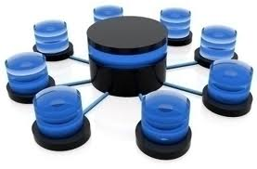
Database Design Methods

Slide 28
Two design methods
Relational
Database normalization is the process of organizing the fields and tables of a relational database to minimize redundancy and dependency. Normalization usually involves dividing large tables into smaller (and less redundant) tables and defining relationships between them. The objective is to isolate data so that additions, deletions, and modifications of a field can be made in just one table and then propagated through the rest of the database via the defined relationships.”

Slide 29
Two design methods
Dimensional
Dimensional modeling always uses the concepts of facts (measures), and dimensions (context). Facts are typically (but not always) numeric values that can be aggregated, and dimensions are groups of hierarchies and descriptors that define the facts

Slide 30
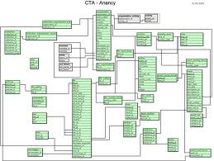
Relational

Slide 31
Relational
Relational Analysis
Database design is usually in Third Normal Form
Database is optimized for transaction processing. (OLTP)
Normalized tables are optimized for modification rather than retrieval

Slide 32
Normal forms
1st - Under first normal form, all occurrences of a record type must contain the same number of fields.
2nd - Second normal form is violated when a non-key field is a fact about a subset of a key. It is only relevant when the key is composite
3rd - Third normal form is violated when a non-key field is a fact about another non-key field
Source: William Kent - 1982

Slide 33
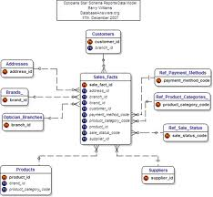
Dimensional

Slide 34
Dimensional
Dimensional Analysis
Star Schema/Snowflake
Database is optimized for analytical processing. (OLAP)
Facts and Dimensions optimized for retrieval
Facts – Business events – Transactions
Dimensions – context for Transactions
People
Accounts
Products
Date

Slide 35
Relational
3 Dimensions
Spatial Model
No historical components except for transactional tables
Relational – Models the one truth of the data
One account ‘11’
One person ‘Terry Bunio’
One transaction of ‘$100.00’ on April 10th

Slide 36
Dimensional
4 Dimensions
Temporal Model
All tables have a time component
Dimensional – Models the data over time
Multiple versions of Accounts over time
Multiple versions of people over time
One transaction
Transactions are already temporal

Slide 37


Slide 38

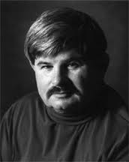

Slide 39
Kimball-lytes
Bottom-up - incremental
Operational systems feed the Data Warehouse
Data Warehouse is a corporate dimensional model that Data Marts are sourced from
Data Warehouse is the consolidation of Data Marts
Sometimes the Data Warehouse is generated from Subject area Data Marts

Slide 40
Inmon-ians
Top-down
Corporate Information Factory
Operational systems feed the Data Warehouse
Enterprise Data Warehouse is a corporate relational model that Data Marts are sourced from
Enterprise Data Warehouse is the source of Data Marts

Slide 41
The gist…
Kimball’s approach is easier to implement as you are dealing with separate subject areas, but can be a nightmare to integrate
Inmon’s approach has more upfront effort to avoid these consistency problems, but takes longer to implement.

Slide 42

Facts

Slide 43
Fact Tables
Contains the measurements or facts about a business process
Are thin and deep
Usually is:
Business transaction
Business Event
The grain of a Fact table is the level of the data recorded.

Slide 44
Fact Tables
Contains the following elements
Primary Key - Surrogate
Timestamp
Measure or Metrics
Transaction Amounts
Foreign Keys to Dimensions
Degenerate Dimensions
Transaction indicators or Flags

Slide 45
Fact Tables
Types of Measures
Additive - Measures that can be added across any dimensions.
Amounts
Non Additive - Measures that cannot be added across any dimension.
Rates
Semi Additive - Measures that can be added across some dimensions.
Don’t have a good example

Slide 46
Fact Tables
Types of Fact tables
Transactional - A transactional table is the most basic and fundamental. The grain associated with a transactional fact table is usually specified as "one row per line in a transaction“.
Periodic snapshots - The periodic snapshot, as the name implies, takes a "picture of the moment", where the moment could be any defined period of time.
Accumulating snapshots - This type of fact table is used to show the activity of a process that has a well-defined beginning and end, e.g., the processing of an order. An order moves through specific steps until it is fully processed. As steps towards fulfilling the order are completed, the associated row in the fact table is updated.

Slide 47
Special Fact Tables
Degenerate Dimensions
Degenerate Dimensions are Dimensions that can typically provide additional context about a Fact
For example, flags that describe a transaction
Degenerate Dimensions can either be a separate Dimension table or be collapsed onto the Fact table
My preference is the latter

Slide 48
Special Fact Tables
If Degenerate Dimensions are not collapsed on a Fact table, they are called Junk Dimensions and remain a Dimension table
Junk Dimensions can also have attributes from different dimensions
Not recommended

Slide 49
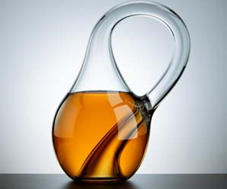
Dimensions

Slide 50
Dimension Tables
Unlike fact tables, dimension tables contain descriptive attributes that are typically textual fields
These attributes are designed to serve two critical purposes:
query constraining and/or filtering
query result set labeling.
Source: Wikipedia

Slide 51
Dimension Tables
Shallow and Wide
Usually corresponds to entities that the business interacts with
People
Locations
Products
Accounts

Slide 52

Time Dimension

Slide 53
Time Dimension
All Dimensional Models need a time component
This is either a:
Separate Time Dimension (recommended)
Time attributes on each Fact Table

Slide 54
Dimension Tables
Contains the following elements
Primary Key – Surrogate
Business Natural Key
Person ID
Effective and Expiry Dates
Descriptive Attributes
Includes de-normalized reference tables

Slide 55
Behavioural Dimensions
A Dimension that is computed based on Facts is termed a behavioural dimension

Slide 56
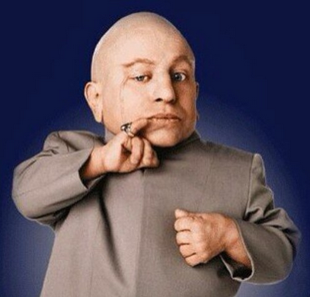
Mini-Dimensions

Slide 57
Mini-Dimensions
Splitting a Dimension up due to the activity of change for a set of attributes
Helps to reduce the growth of the Dimension table

Slide 58
Slowly Changing Dimensions
Type 1 – Overwrite the row with the new values and update the effective date
Pre-existing Facts now refer to the updated Dimension
May cause inconsistent reports

Slide 59
Slowly Changing Dimensions
Type 2 – Insert a new Dimension row with the new data and new effective date
Update the expiry date on the prior row
Don’t update old Facts that refer to the old row
Only new Facts will refer to this new Dimension row
Type 2 Slowly Changing Dimension maintains the historical context of the data

Slide 60
Slowly Changing Dimensions
A type 2 change results in multiple dimension rows for a given natural key
A type 2 change results in multiple dimension rows for a given natural key
A type 2 change results in multiple dimension rows for a given natural key

Slide 61
Slowly Changing Dimensions
No longer to I have one row to represent:
Account 10123
Terry Bunio
Sales Representative 11092
This changes the mindset and query syntax to retrieve data

Slide 62
Slowly Changing Dimensions
Type 3 – The Dimension stores multiple versions for the attribute in question
This usually involves a current and previous value for the attribute
When a change occurs, no rows are added but both the current and previous attributes are updated
Like Type 1, Type 3 does not retain full historical context

Slide 63
Slowly Changing Dimensions
You can also create hybrid versions of Type 1, Type 2, and Type 3 based on your business requirements

Slide 64
Type 1/Type 2 Hybrid
Most common hybrid
Used when you need history AND the current name for some types of statutory reporting

Slide 65
Frozen Attributes
Some times it is required to freeze some attributes so that they are not Type 1, Type 2, or Type 3
Usually for audit or regulatory requirements

Slide 66
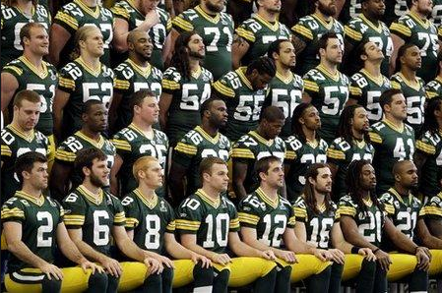
Conformity

Slide 67
Recall - Kimball-lytes
Bottom-up - incremental
Operational systems feed the Data Warehouse
Data Warehouse is a corporate dimensional model that Data Marts are sourced from
Data Warehouse is the consolidation of Data Marts
Sometimes the Data Warehouse is generated from Subject area Data Marts

Slide 68
The problem
Kimball’s approach can led to Dimensions that are not conforming
This is due to the fact that separate departments define what a client or product is
Some times their definitions do not agree

Slide 69
Conforming Dimension
A Dimension is said to be conforming if:
A conformed dimension is a set of data attributes that have been physically referenced in multiple database tables using the same key value to refer to the same structure, attributes, domain values, definitions and concepts. A conformed dimension cuts across many facts.
Dimensions are conformed when they are either exactly the same (including keys) or one is a perfect subset of the other.

Slide 70
If you take one thing away
Ensure that your Dimensions are conformed

Slide 71
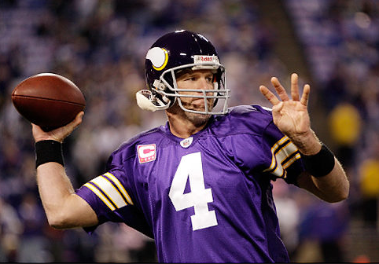
Complexity

Slide 72
Complexity
Most textbooks stop here only show the simplest Dimensional Models
Unfortunately, I’ve never run into a Dimensional Model like that

Slide 73
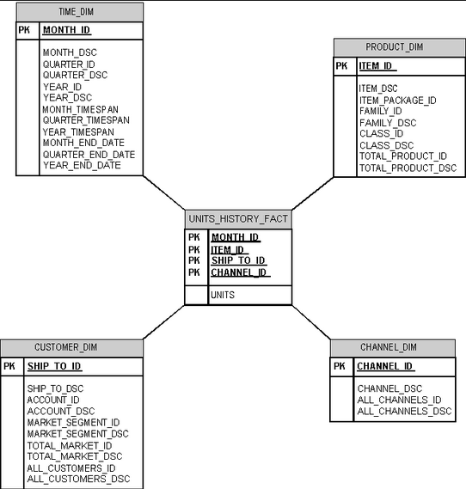
Simple

Slide 74
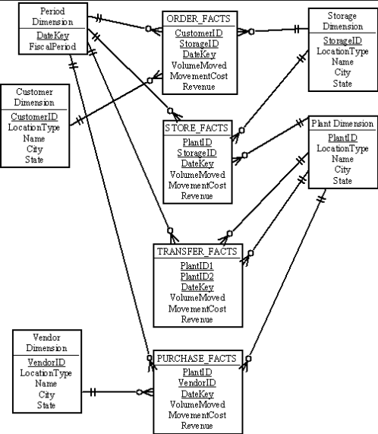
More Complex

Slide 75
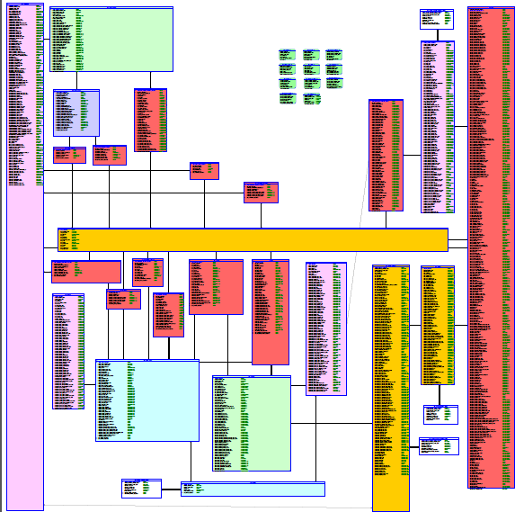
Real World

Slide 76
Complex Concept Introduction
Snowflake vs Star Schema
Multi-Valued Dimensions and Bridges
Multi-Valued Attributes
Factless Facts
Recursive Hierarchies

Slide 77
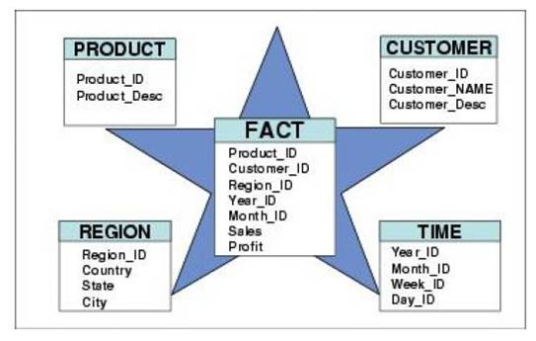
Snowflake vs Star Schema

Slide 78
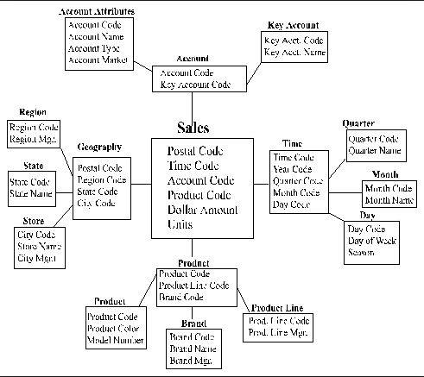
Snowflake vs Star Schema

Slide 79
Snowflake vs Star Schema
These extra table are termed outriggers
They are used to address real world complexities with the data
Excessive row length
Repeating groups of data within the Dimension
I will use outriggers in a limited way for repeating data

Slide 80
Multi-Valued Dimensions
Multi-Valued Dimensions are when a Fact needs to connect more than once to a Dimension
Primary Sales Representative
Secondary Sales Representative

Slide 81
Multi-Valued Dimensions
Two possible solutions
Create copies of the Dimensions for each role
Create a Bridge table to resolve the many to many relationship

Slide 82
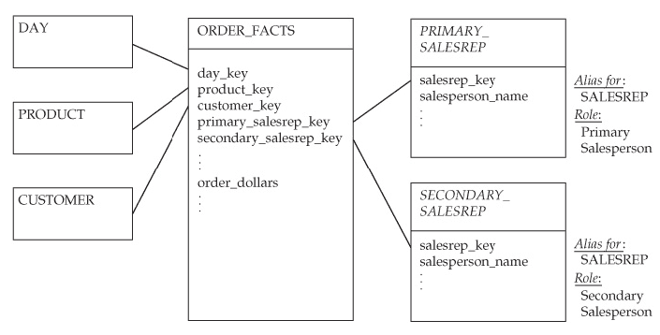
Multi-Valued Dimensions

Slide 83
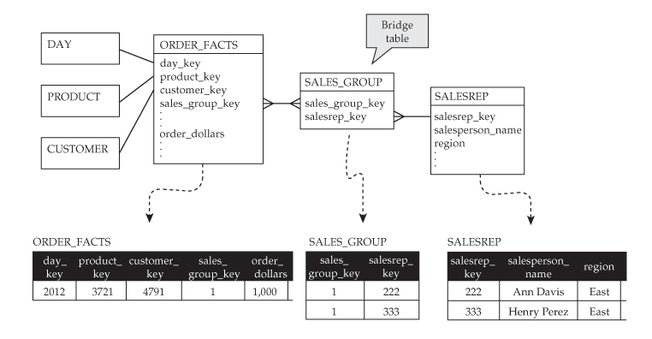
Bridge Tables

Slide 84
Bridge Tables
Bridge Tables can be used to resolve any many to many relationships
This is frequently required with more complex data areas
These bridge tables need to be considered a Dimension and they need to use the same Slowly Changing Dimension Design as the base Dimension
My Recommendation

Slide 85
Multi-Valued Attributes
In some cases, you will need to keep multiple values for an attribute or sets of attributes
Three solutions
Outriggers or Snowflake (1:M)
Bridge Table (M:M)
Repeat attributes on the Dimension
Simplest solution but can be hard to query and causes long record length

Slide 86
Factless Facts
Fact table with no metrics or measures
Used for two purposes:
Records the occurrence of activities. Although no facts are stored explicitly, these events can be counted, producing meaningful process measurements.
Records significant information that is not part of a business activity. Examples of conditions include eligibility of people for programs and the assignment of Sales Representatives to Clients

Slide 87

Hierarchies and Recursive Hierarchies

Slide 88
Hierarchies and Recursive Hierarchies
We would need a separate session to cover this topic
Solution involves defining Dimension tables to record the Hierarchy with a special solution to address the Slowly Changing Dimension Hierarchy
Any change in the Hierarchy can result in needing to duplicate the Hierarchy downstream

Slide 89
Why?
Why Dimensional Model?
Allows for a concise representation of data for reporting. This is especially important for Self-Service Reporting
We reduced from 400+ tables in our Operational Data Store to 60+ tables in our Data Warehouse
Aligns with real world business concepts

Slide 90
Why?
The most important reason –
Requires detailed and deeper understanding of the data
Validates the solution
Uncovers inconsistencies and errors in the Normalized Model
Easy for inconsistencies and errors to hide in 400+ tables
No place to hide when those tables are reduced down

Slide 91
Why?
Ultimately there must be a business requirement for a temporal data model and not just a spatial one.
Although you could go through the exercise to validate your understanding and not implement the Dimensional Data Model

Slide 92

How?

Slide 93
How?
Start with your simplest Dimension and Fact tables and define the Natural Keys for them
i.e. People, Product, Transaction, Time
De-Normalize Reference tables to Dimensions (And possibly Facts based on how large the Fact tables will be)
I place both codes and descriptions on the Dimension and Fact tables
Look to De-normalize other tables with the same Cardinality into one Dimension
Validate the Natural Keys still define one row

Slide 94
How?
Don’t force entities on the same Dimension
Tempting but you will find it doesn’t represent the data and will cause issues for loading or retrieval
Bridge table or mini-snowflakes are not bad
I don’t like a deep snowflake, but shallow snowflakes can be appropriate
Don’t fall into the Star-Schema/Snowflake Holy War – Let your data define the solution

Slide 95
How?
Iterate, Iterate, Iterate
Your initial solution will be wrong
Create it and start to define the load process and reports
You will learn more by using the data than months of analysis to try and get the model right

Slide 96

Top 10

Slide 97
Top 10
Copy the design for the Time Dimension from the Web. Lots of good solutions with scripts to prepopulate the dimension
Make all your attributes Not-Null. This makes Self-Service Report writing easy
Create a single Surrogate Primary Key for Dimensions – This will help to simplify the design and table width
These FKs get created on Fact tables !

Slide 98
Top 10
Never reject a record
Create an Dummy Invalid record on Each Dimension. Allows you to store a Fact record when the relationship is missing
Choose a Type 2 Slowly Changing Dimension as your default
Use Effective and Expiry dates on your Dimensions to allow for maximum historical information
If they are Type 2!

Slide 99
Top 10
SSIS 2012 has some built-in functionality for processing Slowly Changing Dimensions – Check it out!
Add “Current_ind” and “Dummy_ind” attributes to each Dimension to assist in Report writing
Iterate, Iterate, Iterate
Read this book

Slide 100


Slide 101


Slide 102

Whew! Questions?

